Slide 1
MVC HTML Helper Class Methods
HTML Helper Class is a Collections of Extension Methods.
In MVC the functionality of a View is to display output, we can treat it as a client or Web Form in a traditional web form application.
For rapid development of a View we can use HTML helper class. It contains many extension methods that we can use to create a HTML element.
HtmlHelper class generates html elements using the model class object in razor view.
It binds the model object to html elements to display value of model properties into html elements and also assigns the value of the html elements to the model properties while submitting web form.
HTML Helper Methods are divided into 3 types
1. Standard HTML helper
2. Strongly typed HTML helper
3. Template HTML helper
4.Tag helpers

Slide 2
Standard HTML helper
These helpers are used to render the most common types of HTML elements such as HTML text boxes, checkboxes and so on.
Html.ActionLink()
Html.BeginForm()
Html.EndForm()
Html.TextBox()
Html.Password()
Html.CheckBox()
Html.RadioButton()
Html.DropDownList()
Html.Hidden()
Html.ListBox()
Html.TextArea()

Slide 3
Standard HTML helper
Form:
<div>
@{
Html.BeginForm("action", "controller", "POST");
Html.EndForm();
}
</div>
TextBox
@Html.TextBox("name");
@Html.TextBox("StudentName", null, new { @class = "form-control" })
@Html.TextBox("myTextBox", "This is value", new { @class = "form-control" })

Slide 4
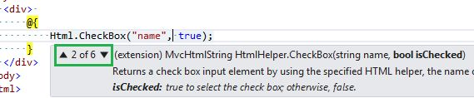
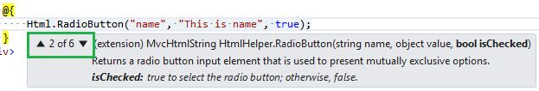
Standard HTML helper
CheckBox:
Radio Button

Slide 5
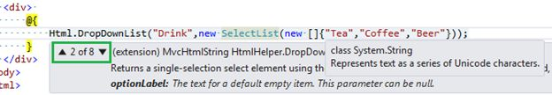
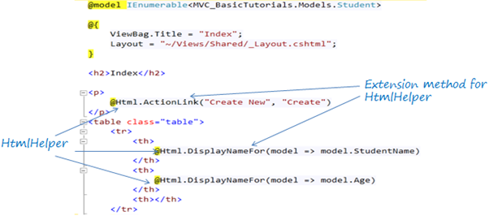
Standard HTML helper
Drop Down list

Slide 6
Strongly Typed HTML Helpers
These helpers are used to render the most common types of HTML elements in a strongly typed view such as HTML text boxes, checkboxes and so on.
The HTML elements are created based on model properties.
The strongly typed HTML helpers work on lambda expressions.
The model object is passed as a value to the lambda expression and you can select the field or property from the model object to be used to set the id, name and value attributes of the HTML helper.

Slide 7
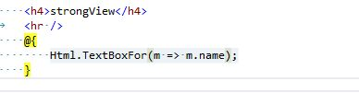


Strongly Typed HTML Helpers
Text Box
Password Type
Multi Select List

Slide 8


Template HTML helper
Display Renders a read-only view of the specified model property and selects an appropriate HTML element based on the property's data type and metadata. DisplayFor() is to point to a model property in the strongly typed view.
Editor Renders an editor for the specified model property and selects an appropriate HTML element based on the property's data type and metadata,

Slide 9
Template HTML helper
Display Renders a read-only view of the specified model property and selects an appropriate HTML element based on the property's data type and metadata. DisplayFor() is to point to a model property in the strongly typed view.
Editor Renders an editor for the specified model property and selects an appropriate HTML element based on the property's data type and metadata,

Slide 10
HtmlHelper | Strogly Typed HtmlHelpers | Html Control
Html.ActionLink |  | Anchor link
Html.TextBox | Html.TextBoxFor | Textbox
Html.TextArea | Html.TextAreaFor | TextArea
Html.CheckBox | Html.CheckBoxFor | Checkbox
Html.RadioButton | Html.RadioButtonFor | Radio button
Html.DropDownList | Html.DropDownListFor | Dropdown, combobox
Html.ListBox | Html.ListBoxFor | multi-select list box
Html.Hidden | Html.HiddenFor | Hidden field
Password | Html.PasswordFor | Password textbox
Html.Display | Html.DisplayFor | Html text
Html.Label | Html.LabelFor | Label
Html.Editor | Html.EditorFor | Generates Html controls based on data type of specified model property e.g. textbox for string property, numeric field for int, double or other numeric type.

Slide 11
Tag Helpers
Tag Helpers are classes written in C# but are attached to HTML elements in order to run server-side code from Razor view.
Using Tag Helpers
In order to use the inbuilt or custom Tag Helpers, one has to first reference Tag Helper library named Microsoft.AspNetCore.Mvc.TagHelpers. It can also be taken from Nuget. Once referenced, import it using @AddTagHelper directive as shown below inside _ViewImports.cshtml
@addTagHelper *,Microsoft.AspNetCore.Mvc.TagHelpers

Slide 12
BUILT-IN TAG HELPERS
Tag Helpers are classes written in C# but are attached to HTML elements in order to run server-side code from Razor view.
Using Tag Helpers
In order to use the inbuilt or custom Tag Helpers, one has to first reference Tag Helper library named Microsoft.AspNetCore.Mvc.TagHelpers. It can also be taken from Nuget. Once referenced, import it using @AddTagHelper directive as shown below inside _ViewImports.cshtml
@addTagHelper *,Microsoft.AspNetCore.Mvc.TagHelpers

